Slide 1
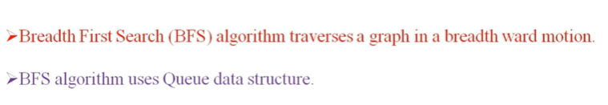

Slide 2
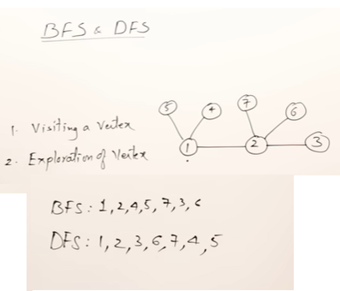
BFS and DFS both are Graph Traversal Method

Slide 3
5
4
7
6
1
2
3

Slide 4
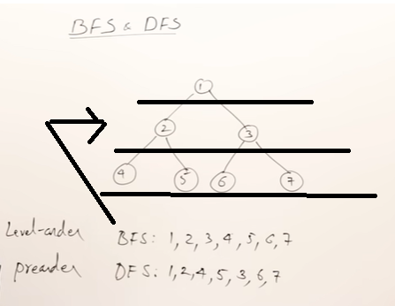

Slide 5
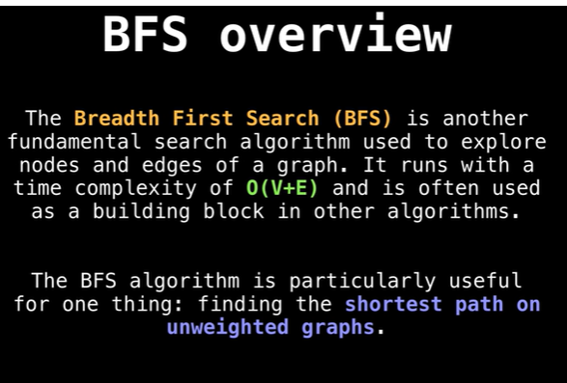
Breadth First Search Algorithm (BFS)

Slide 6
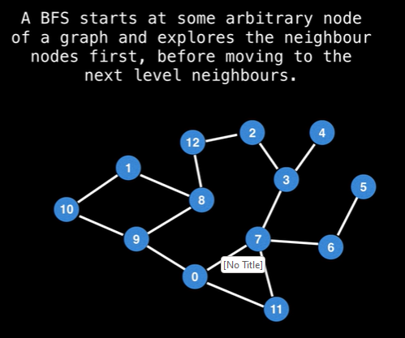

Slide 7
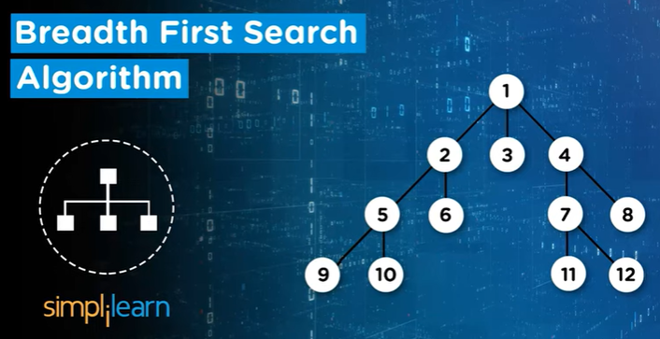

Slide 8
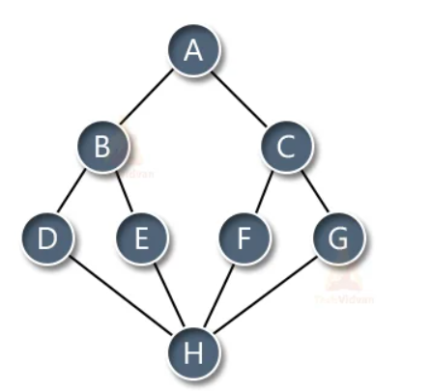

Slide 9
FIRST ITERATION
Select A, put in Q, and Draw graph node of A
Q
A
A

Slide 10
FIRST ITERATION
Select A,
Put in Q
Draw graph node of A
Check Adjacent of A = B, C
Put Adjacent in Q
Put Adjacent in Graph
Finally Cross Out A
Q
A | B | C
A
B
C

Slide 11
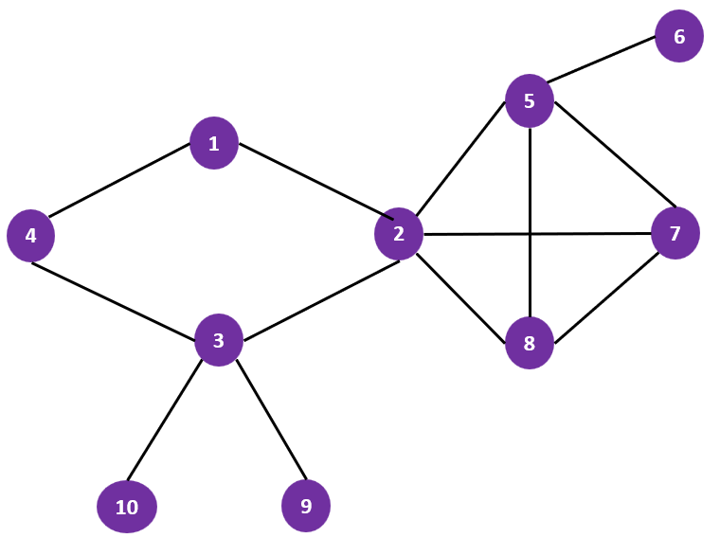
SECOND ITERATION
Select B
Adjacent of B = D, E
Put D, E
Draw graph node of B
Put Adjacent in Graph
Finally Cross Out B
Q
A | B | C | D | E
A
B
C
D
E

Slide 12
THIRD ITERATION
Select C
Adjacent of C = F, G
Put F, G in Queue
Draw graph node of C
Put Adjacent in Graph
Finally Cross Out C
Q
A | B | C | D | E | F | G
A
B
C
D
E
G
F

Slide 13
FOURTH ITERATION
Select D
Adjacent of D = H
Put H in Queue
Draw graph node of D
Put Adjacent in Graph
Finally Cross Out D
Q
A | B | C | D | E | F | G | H
A
B
C
D
E
G
F
H

Slide 14
FIFTH ITERATION
Select E
Adjacent of E = H (H is already connected, but not connected with E, use dotted line)
Put E in Queue
Draw graph node of E
Put Adjacent in Graph
Finally Cross Out E
Q
A | B | C | D | E | F | G | H
A
B
C
D
E
G
F
H

Slide 15
SIXTH ITERATION
Select F
Adjacent of F = H (H is already connected, but not connected with F, use dotted line)
Put F in Queue
Draw graph node of F
Put Adjacent in Graph
Finally Cross Out F
Q
A | B | C | D | E | F | G | H
A
B
C
D
E
G
F
H

Slide 16
SEVENTH ITERATION
Select G
Adjacent of G = H (H is already connected, but not connected with G, use dotted line)
Put F in Queue
Draw graph node of G
Put Adjacent in Graph
Finally Cross Out G
Q
A | B | C | D | E | F | G | H
A
B
C
D
E
G
F
H

Slide 17
SEVENTH ITERATION
Select H
Adjacent of H = All already connected
Put H in Queue
Draw graph node of H
Put Adjacent in Graph
Finally Cross Out H
Q
A | B | C | D | E | F | G | H
A
B
C
D
E
G
F
H

Slide 18
6
5
1
4
2
7
3
8
10
9

Slide 19
FIRST ITERATION
Select 1, put in Q, and Draw graph node of 1
Q
1
1

Slide 20
FIRST ITERATION
Select 1,
Put in Q
Draw graph node of 1
Check Adjacent of 1 = 4, 2
Put Adjacent in Q
Put Adjacent in Graph
Finally Cross Out 1
Q
1 | 4 | 2
1
4
2

Slide 21
SECOND ITERATION
Select 4,
Adjacent of 4 = 1 (Already Connected), 3
Put 3 in Q
Draw graph node of 4
Put Adjacent in Graph
Finally Cross Out 4
Q
1 | 4 | 2 | 3
1
4
2
3

Slide 22
THIRD ITERATION
Select 2,
Adjacent of 2 = 1 (Already Connected with 2), 3 (Connected, but not Connected with 2 it shows with dotted line), 5, 8, 7
Put 5,8,7 in Q
Draw graph node of 5, 8, 7
Put Adjacent in Graph
Finally Cross Out 2
Q
1 | 4 | 2 | 3 | 5 | 8 | 7
1
5
4
2
7
3
8

Slide 23
FOURTH ITERATION
Select 3,
Adjacent of 3 = 4 (Already Connected with 3), 2 (Already Connected with 3), 10, 9
Put 10, 9 in Q
Draw graph node of 10, 9
Put Adjacent in Graph
Finally Cross Out 3
Q
1 | 4 | 2 | 3 | 5 | 8 | 7 | 10 | 9
1
5
4
2
7
3
8
10
9

Slide 24
FOURTH ITERATION
Select 5,
Adjacent of 5 = 2 (Already Connected with 5), 8 (Connected, but not Connected with 5 it shows with dotted line) , 7 (Connected, but not Connected with 5 it shows with dotted line), 6
Put 6 in Q
Draw graph node of 6
Put Adjacent in Graph
Finally Cross Out 5
Q
1 | 4 | 2 | 3 | 5 | 8 | 7 | 10 | 9 | 6
6
1
5
4
2
7
3
8
10
9

Slide 25
FIFTH ITERATION
Select 8,
Adjacent of 8 = 2 (Already Connected with 2), 5 (Connected, but not Connected with 8 it shows with dotted line) , 7 (Connected, but not Connected with 8 it shows with dotted line), 6
Put 6 in Q
Draw graph node of 6
Put Adjacent in Graph
Finally Cross Out 8
Q
1 | 4 | 2 | 3 | 5 | 8 | 7 | 10 | 9 | 6
6
1
5
4
2
7
3
8
10
9

Slide 26
SIXTH ITERATION
Select 7,
Adjacent of 7 = 2 (Already Connected with 7), 5 (Already Connected) , 8 (Already Connected)
Put no element in Q
Not Draw graph
Put Adjacent in Graph
Finally Cross Out 7
Q
1 | 4 | 2 | 3 | 5 | 8 | 7 | 10 | 9 | 6
6
1
5
4
2
7
3
8
10
9

Slide 27
SEVENTH ITERATION
Similarly Select other as 10, 9 and 6 than cross out
Finally Cross Out 10, 9 and 6
Q
1 | 4 | 2 | 3 | 5 | 8 | 7 | 10 | 9 | 6
6
1
5
4
2
7
3
8
10
9

Slide 28
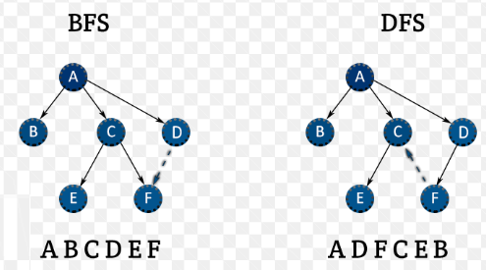

Slide 29
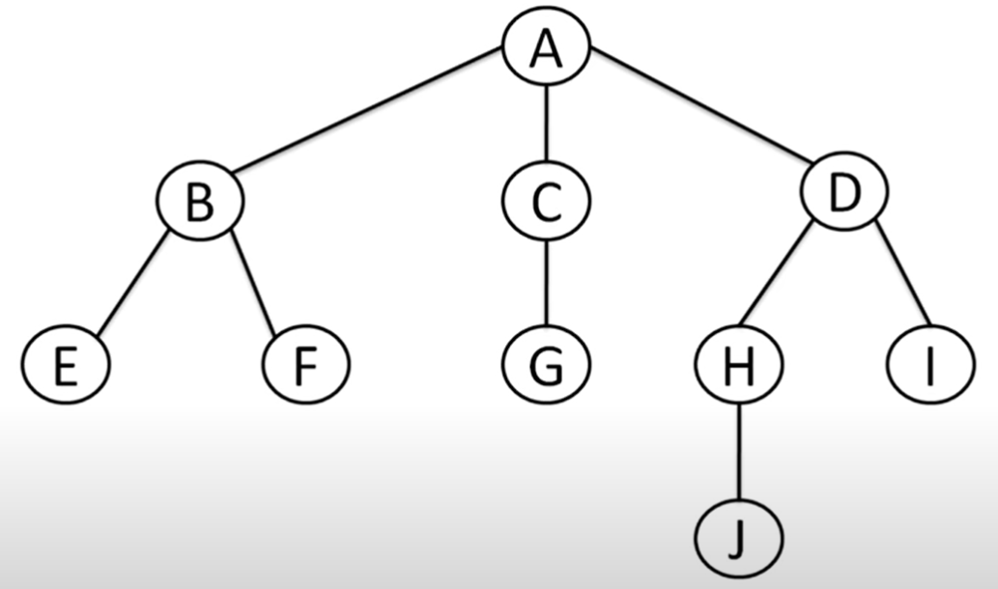
We take a tree structure graph, but you can apply BFS Algorithm on any type of Graph.

Slide 30
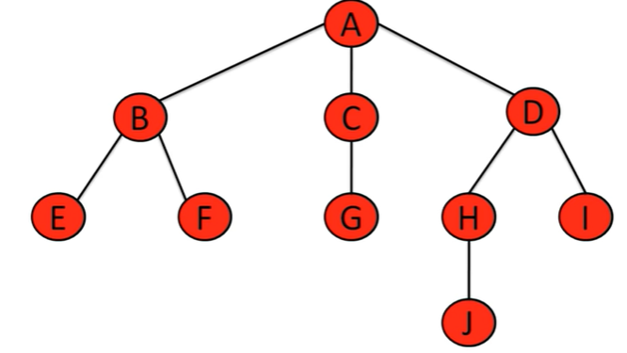
We can visit level wise, such as first we visit start from A than go to A→B, A→C, A→D, B→E, B→F, C→G, D→H, D→I, HA→J

